Slide 1
ENSE 470 milestone 4
Jeremy Cross
Iden Ellia
Abdullah Alasmari

Slide 2

Users

Slide 3
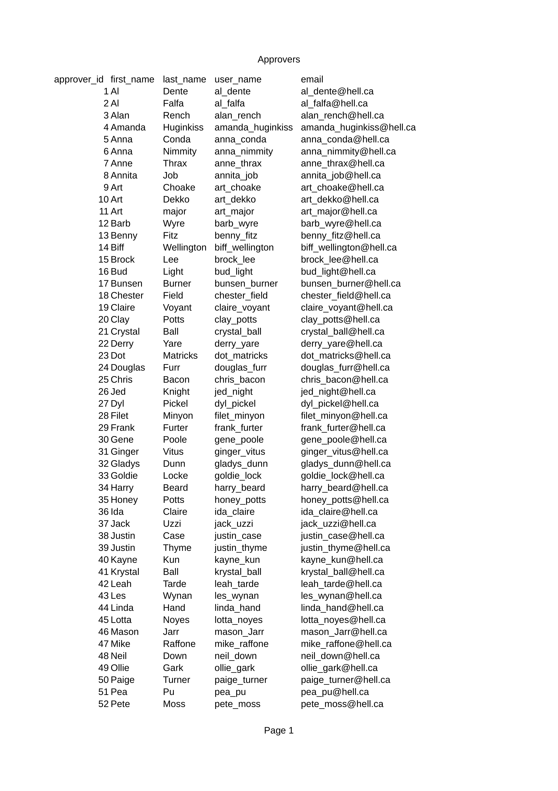
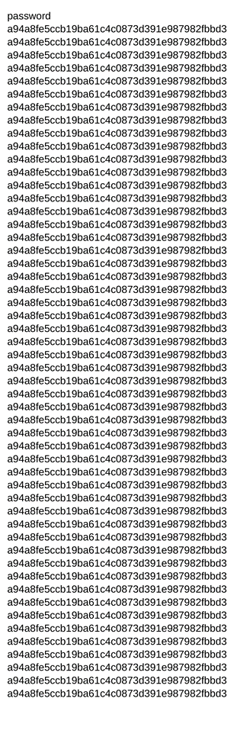
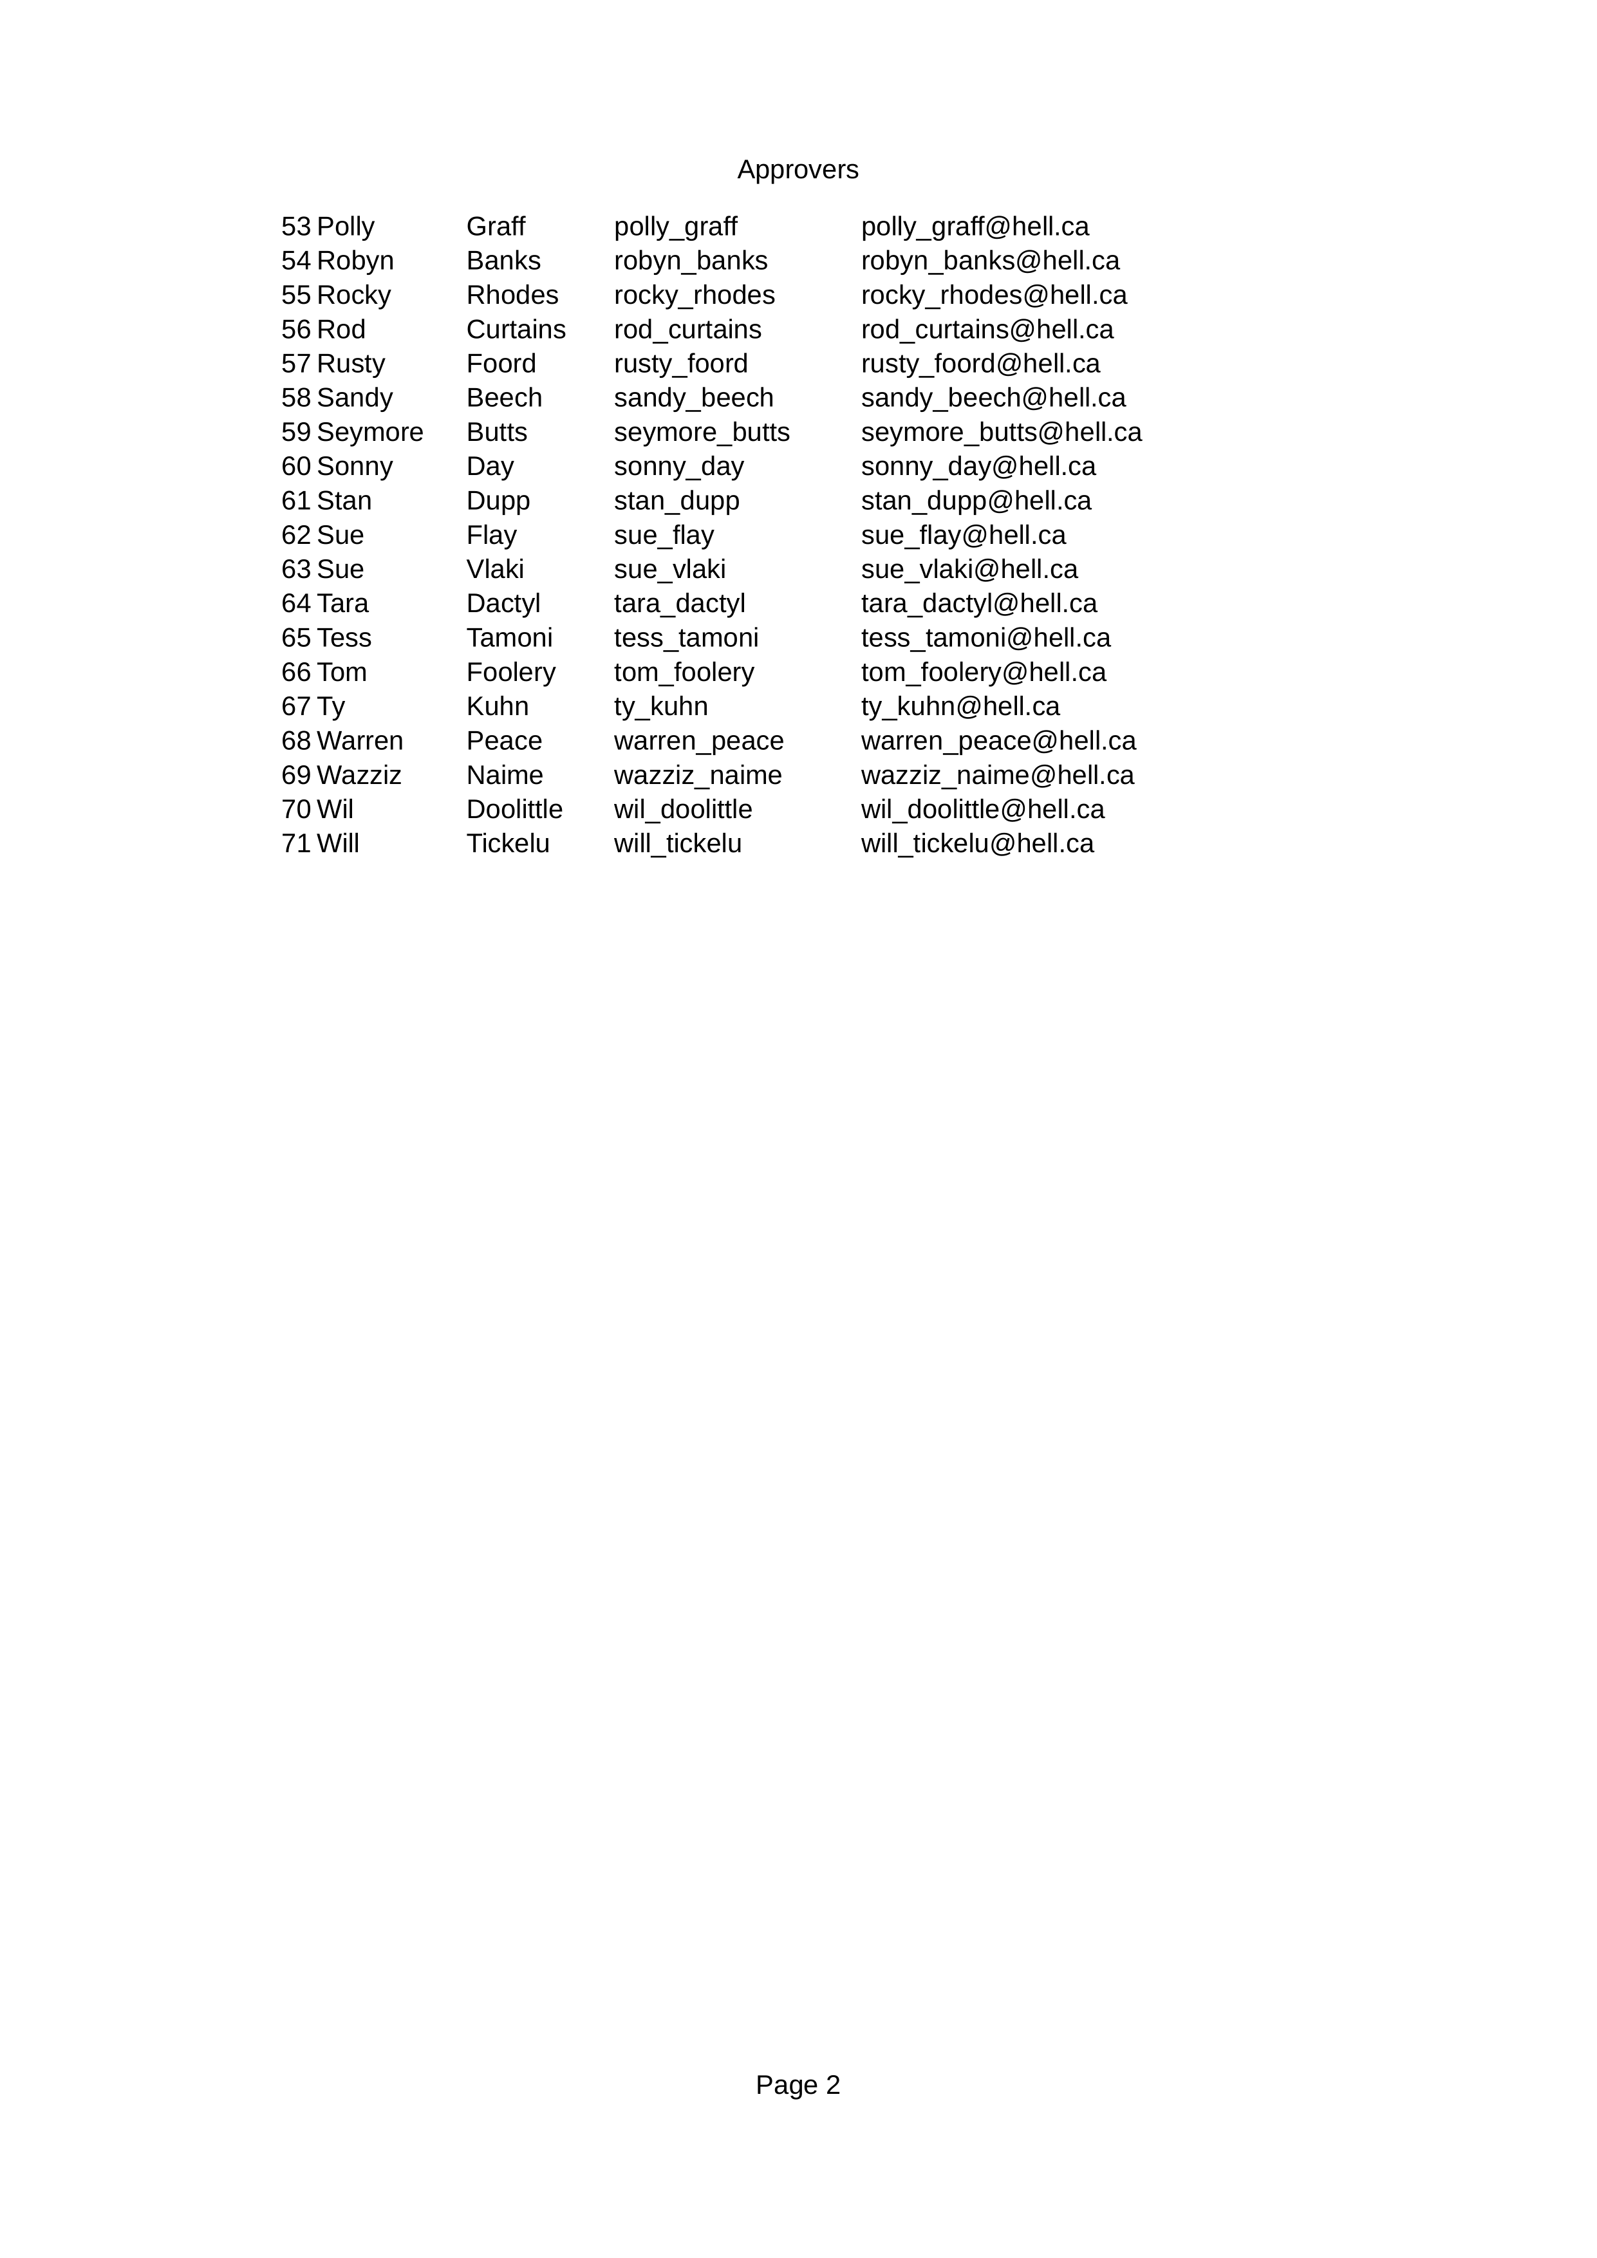
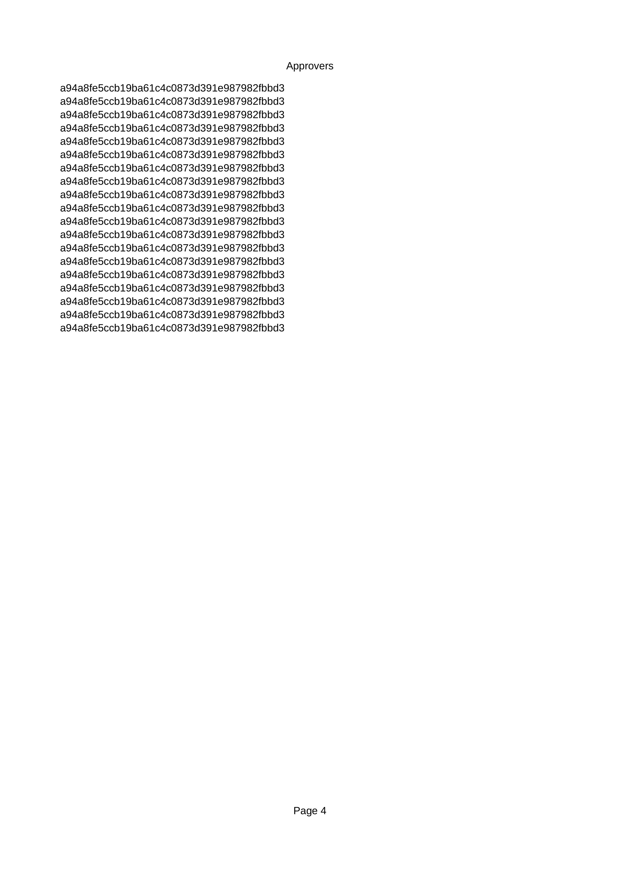
Approvers

Slide 4
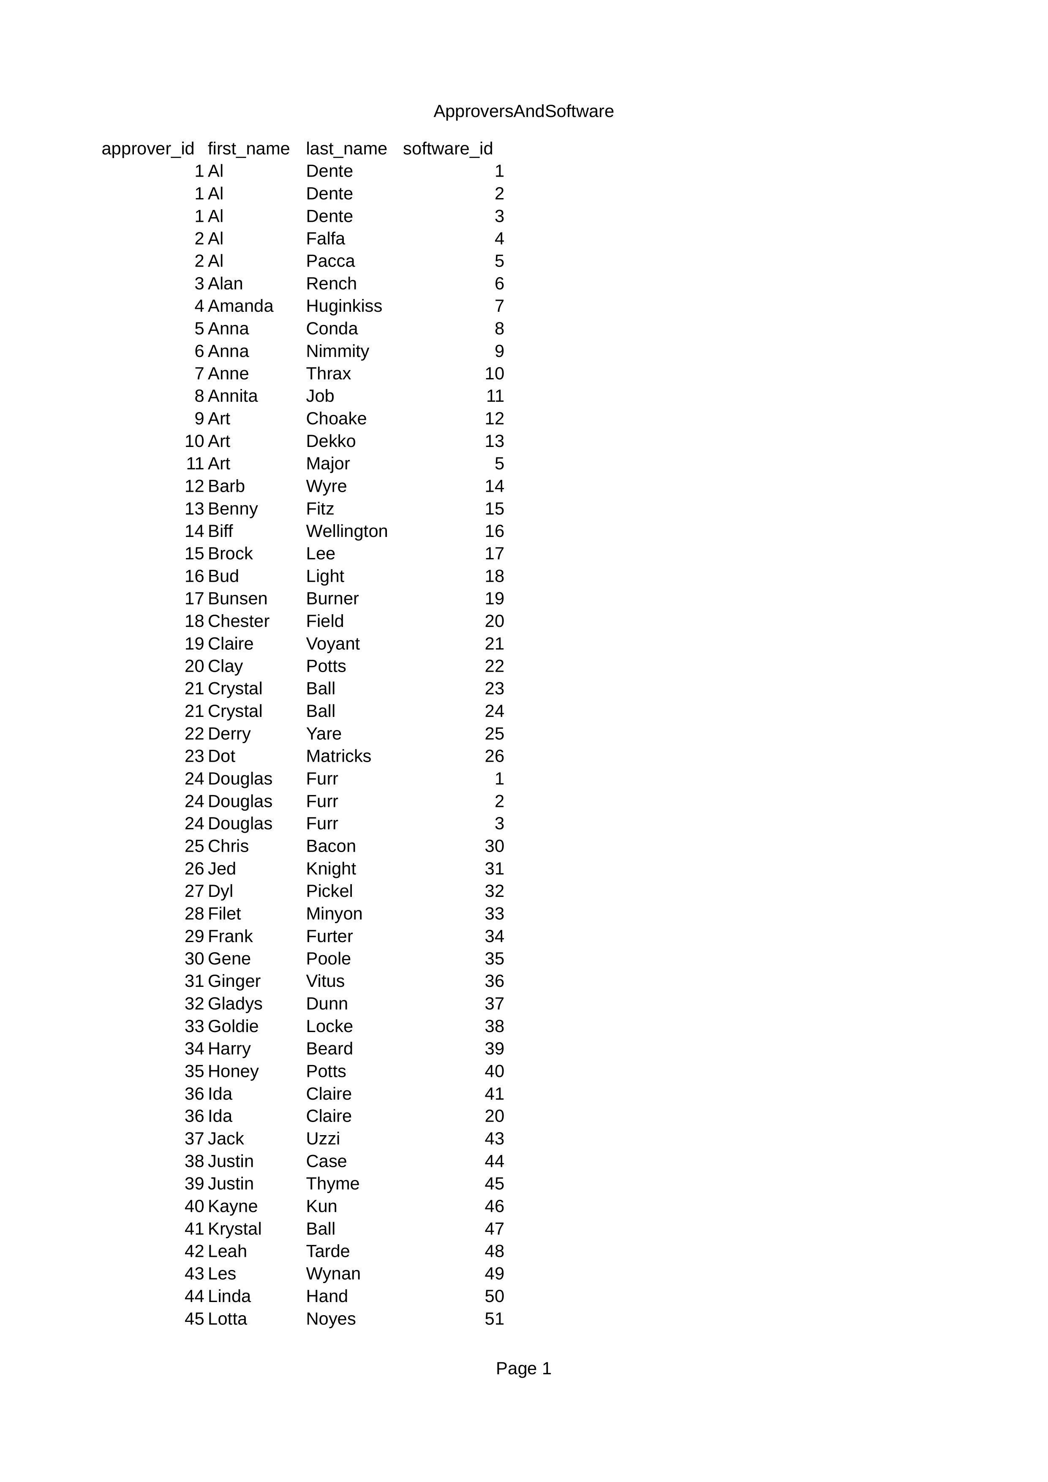
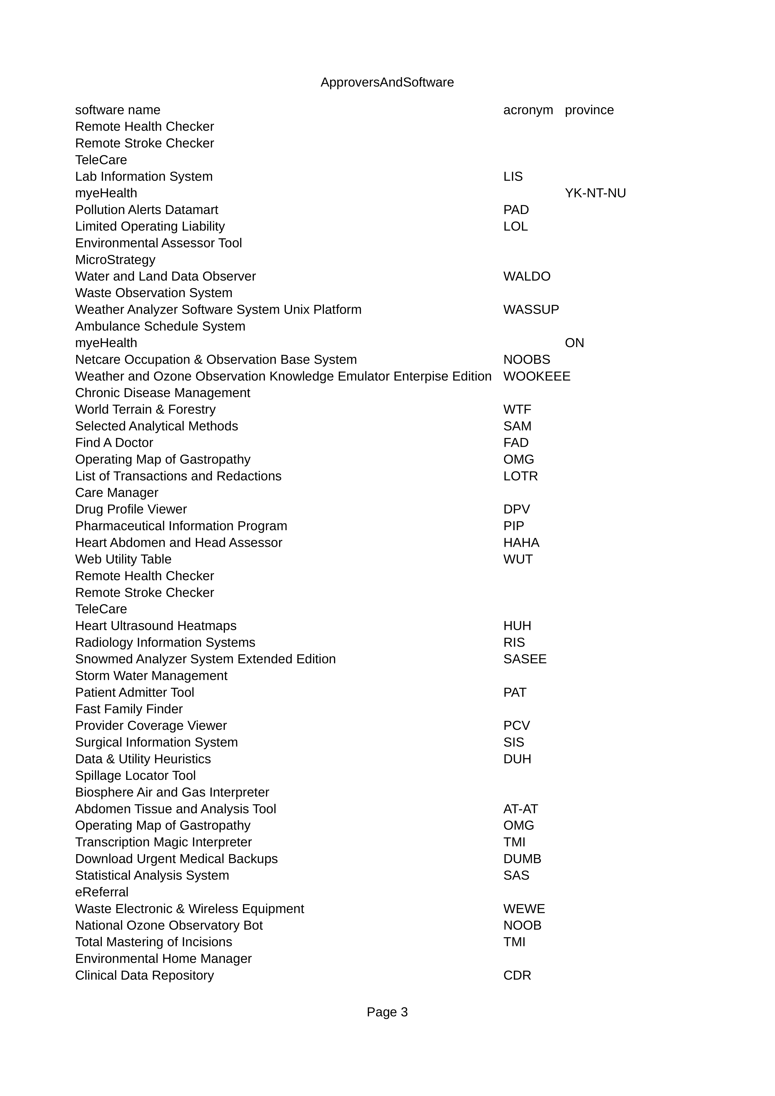
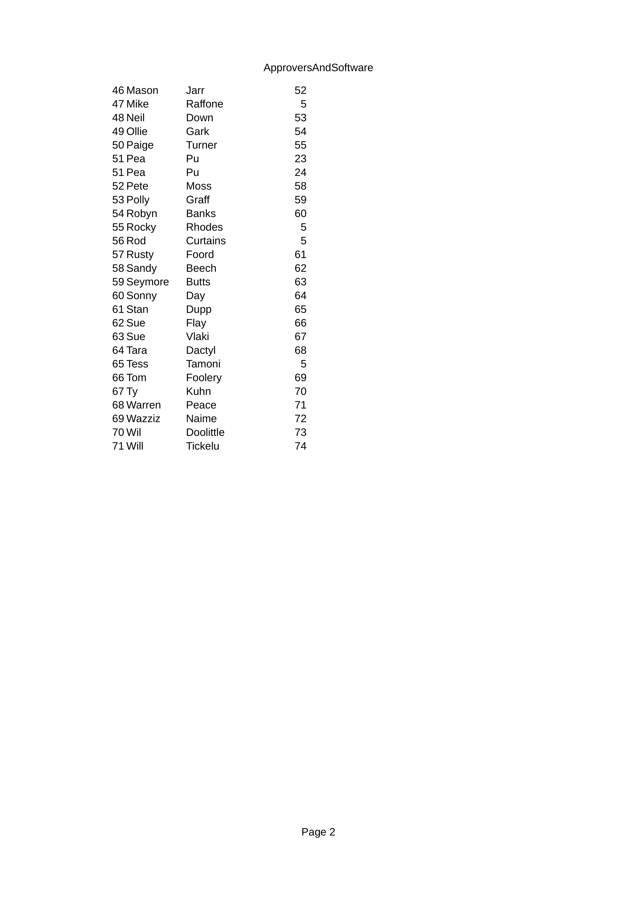
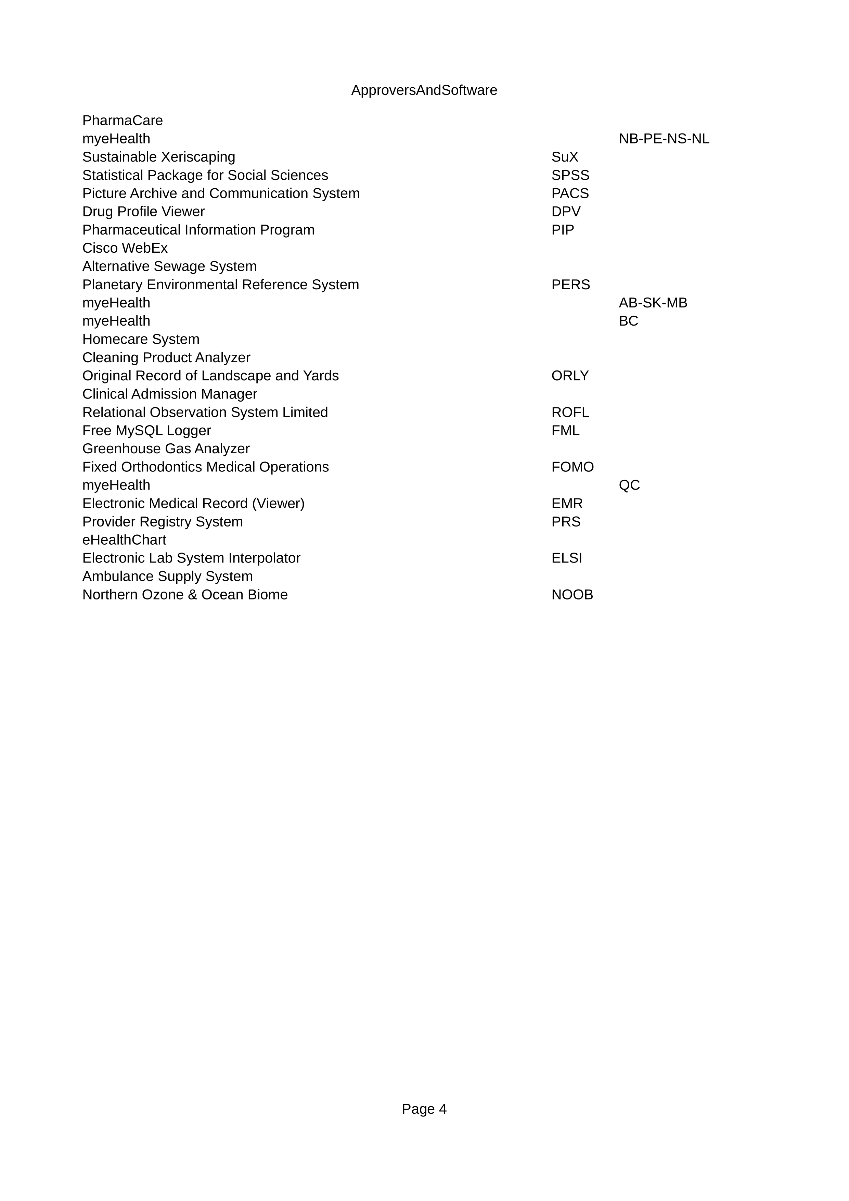
Approvers and software

Slide 5


Analyst

Slide 6

Software Requests

Slide 7
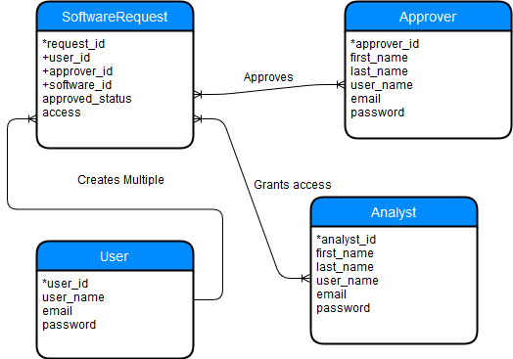

Slide 8
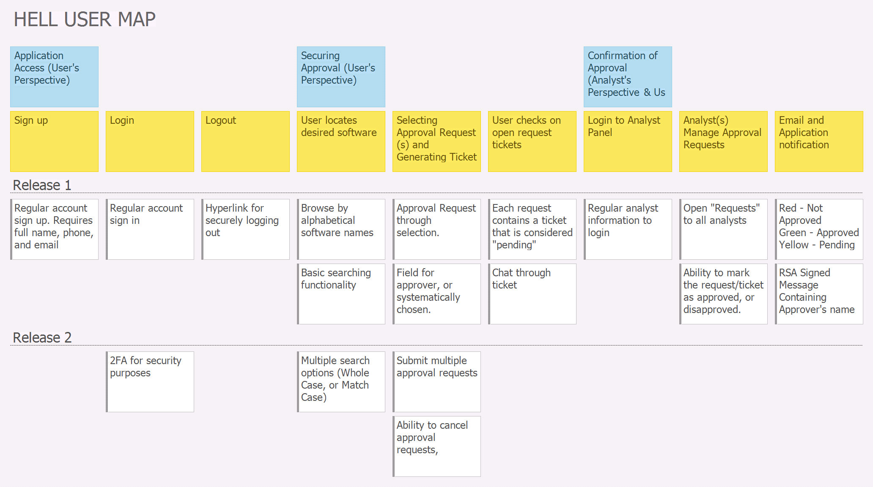
User story map

Slide 9
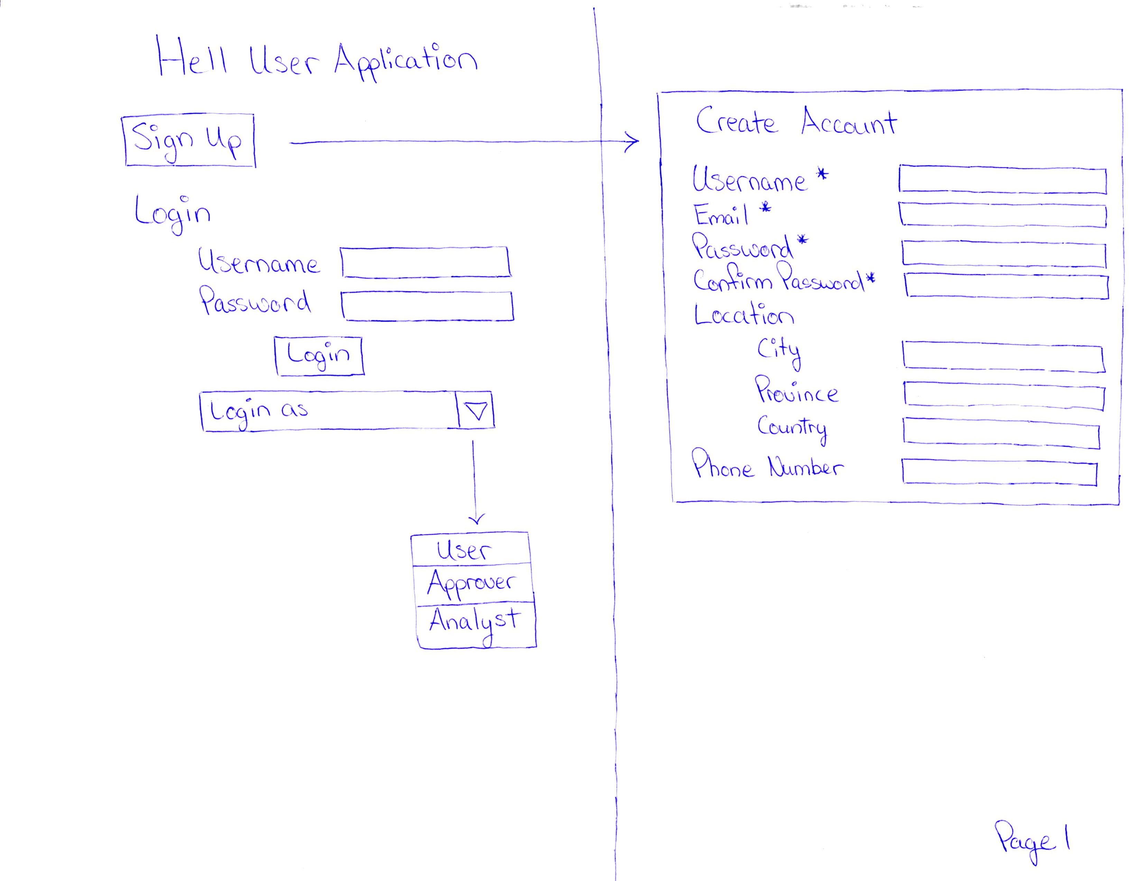

Slide 10
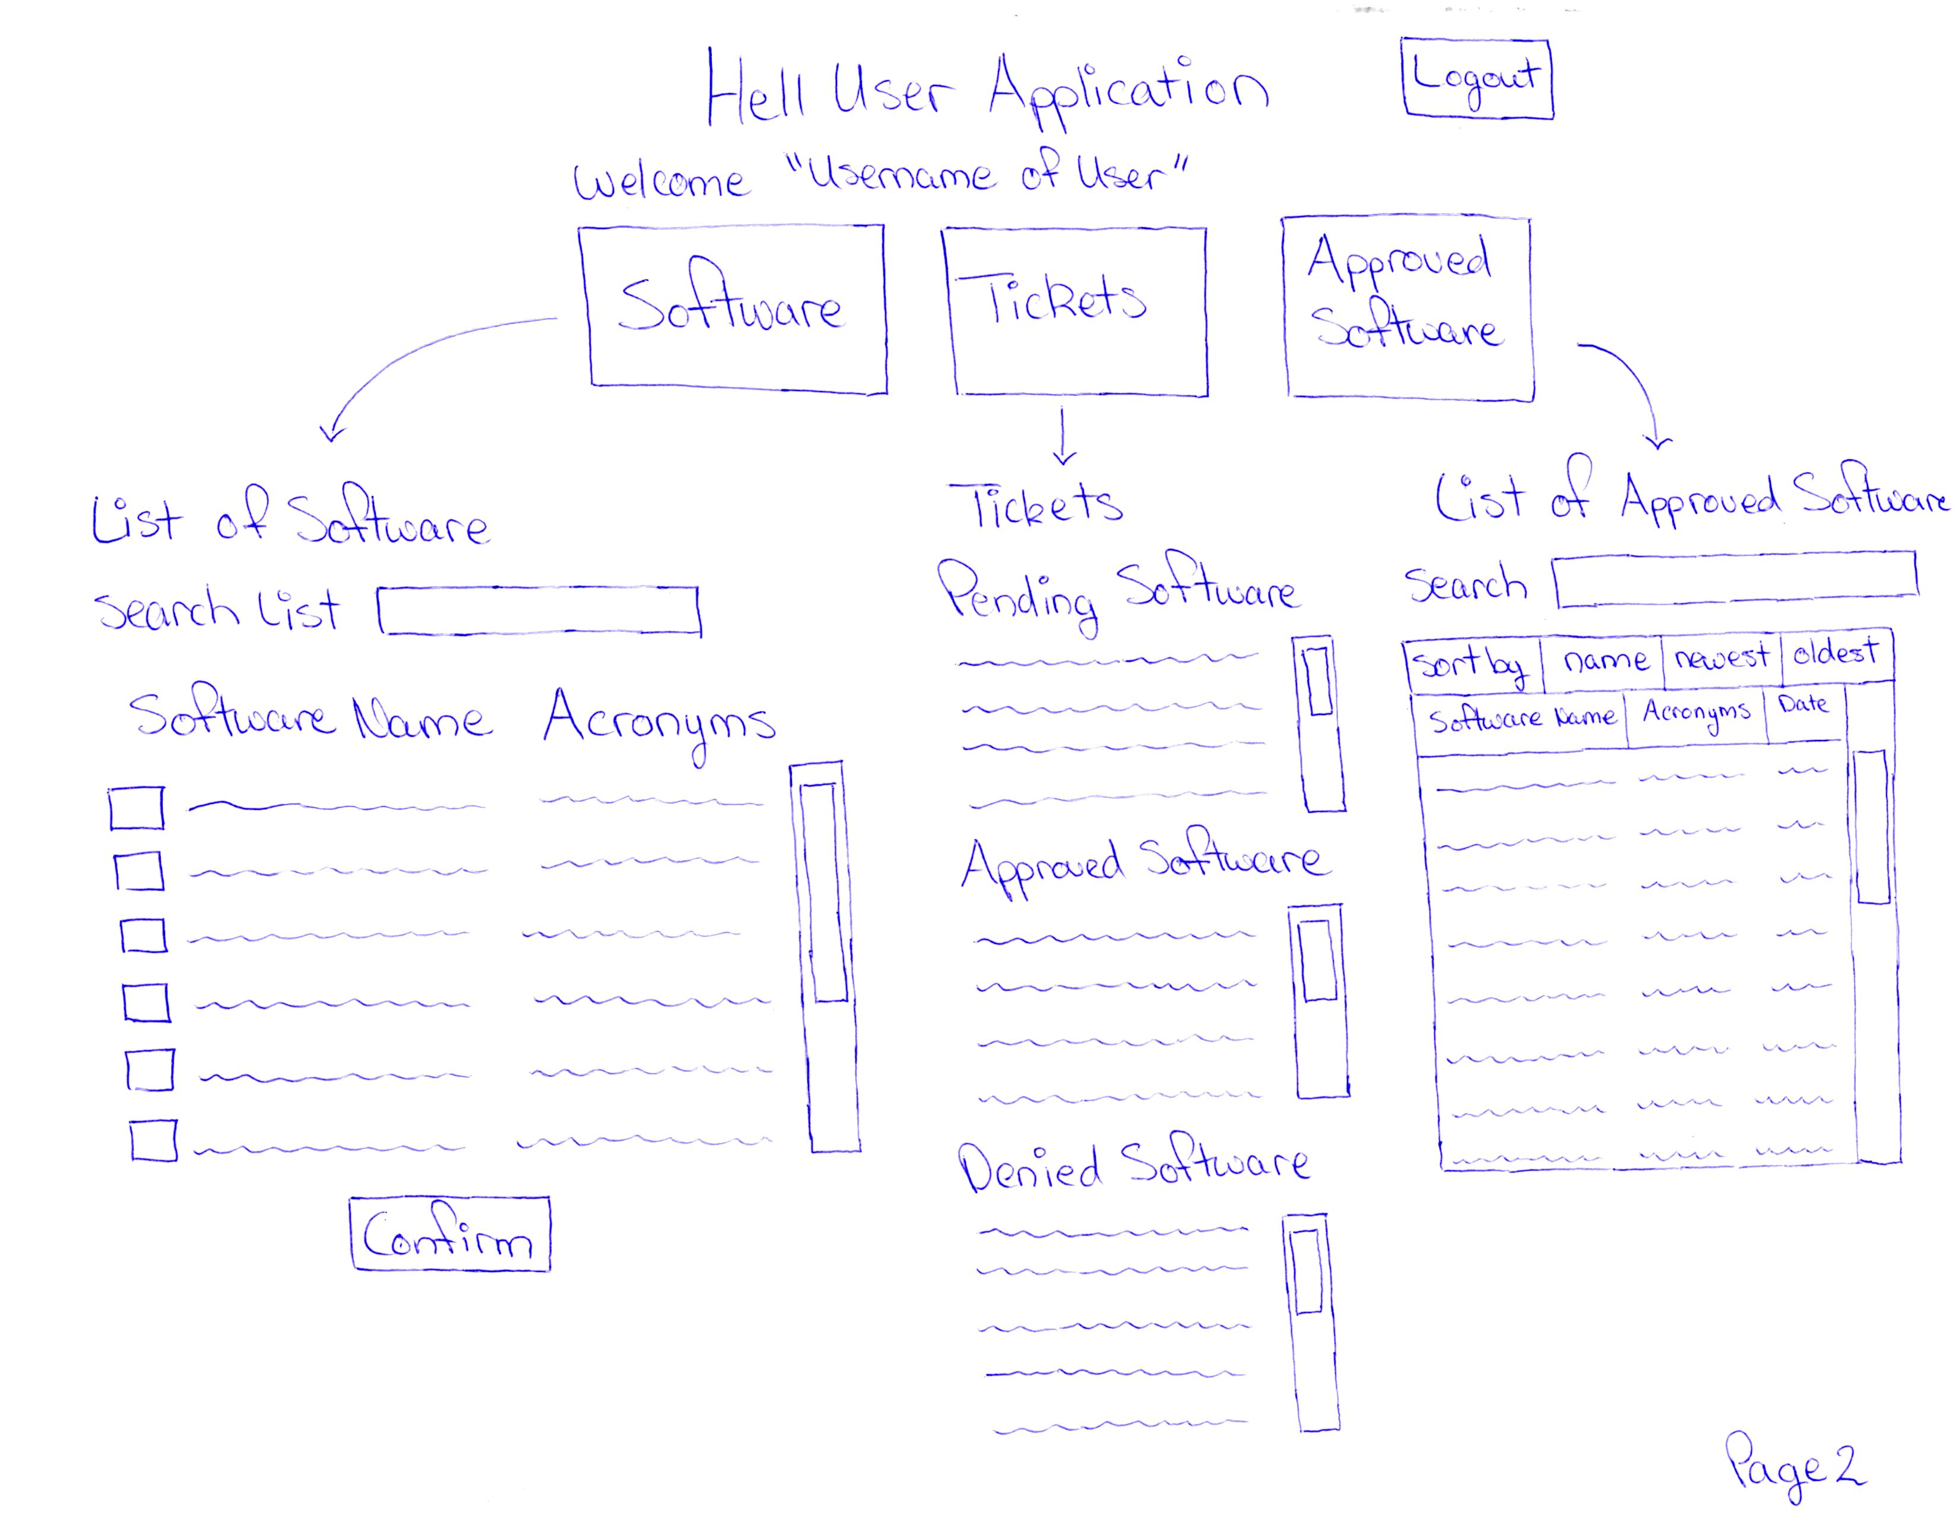

Slide 11
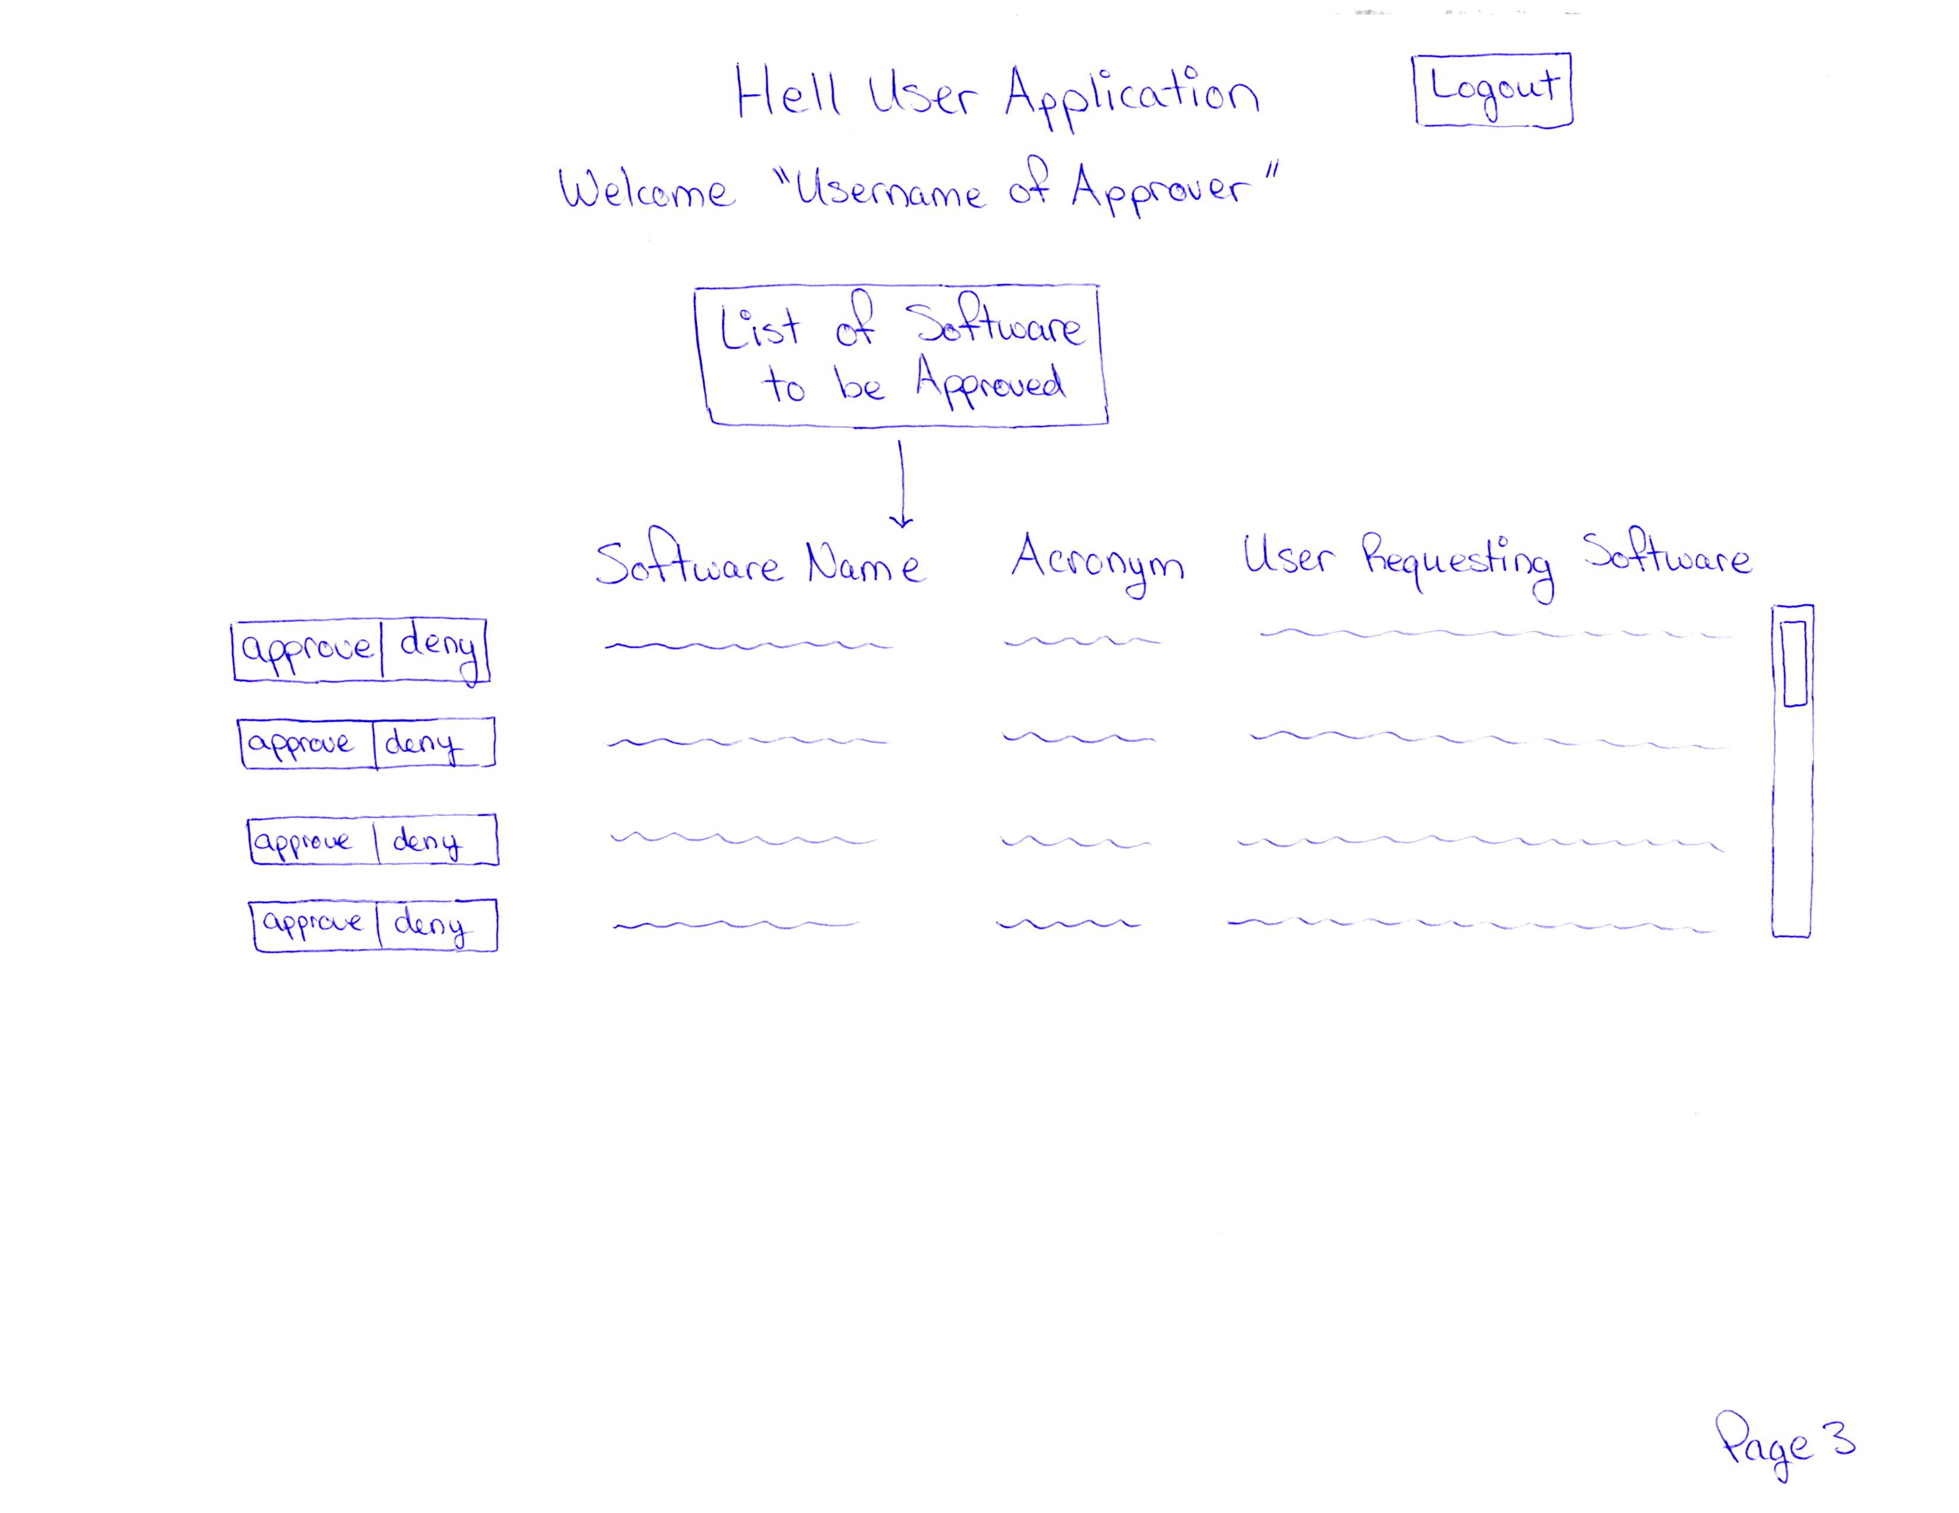

Slide 12
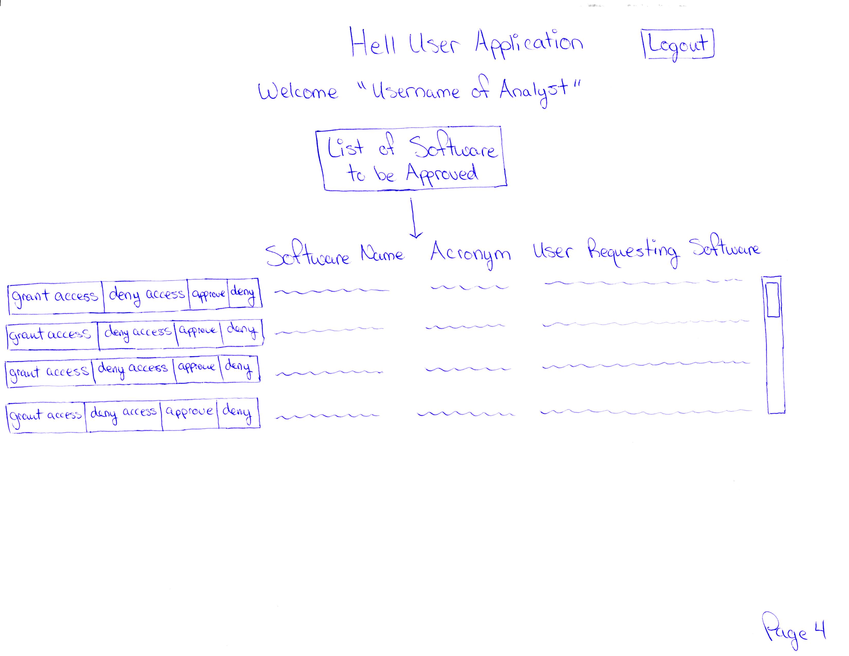

Slide 13
Changes & misc
Have your plans changed since your group’s initial conception and project evolution
Something you saw another team did was intriguing/inspiring
Something you didn’t care for in your initial concept of your future VSM
Add other insights if you like but remember, your group’s report-out must be kept within 5 minutes

Slide 14
Group reflection
How did you feel about this milestone? What did you like about it? What did you dislike?
[Response here]
What did you learn about yourself as you collaborated and worked through this milestone?
[Response here]
How will you use what you have learned going forward?
[Response here]
What “stuff & things” related to this milestone would you want help with?
[Response here]

Slide 15
Questions?

